Slide 1


ECEN 403
Solar Home Lighting 1
Matthew Cepulis
Corey Perlmutter
Thomas Moll
Sara Rueda

Slide 2
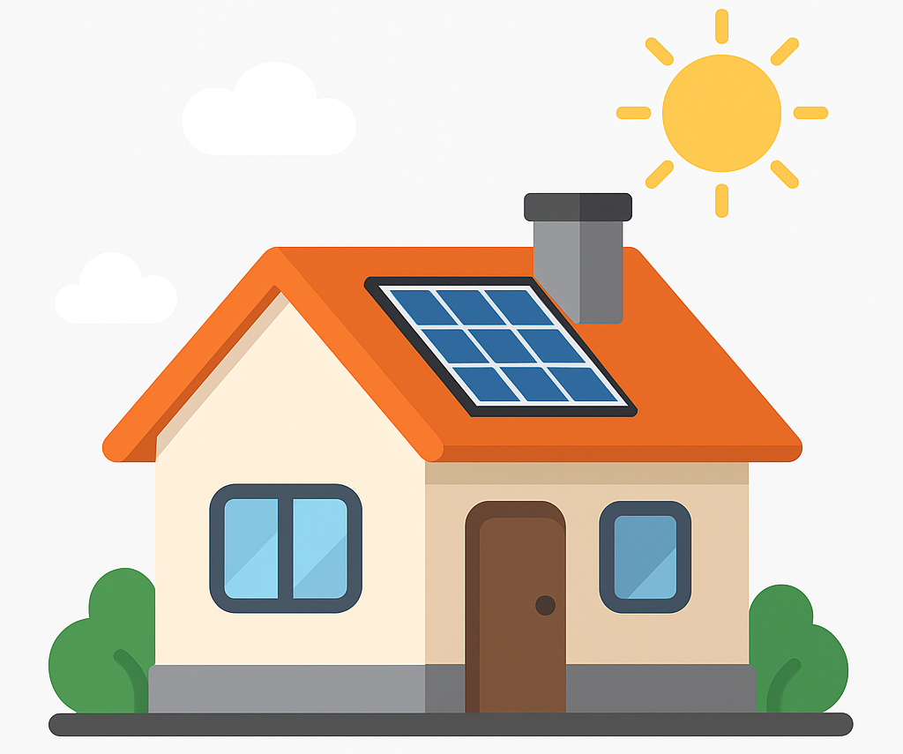
Executive Summary
Problem Statement:
Traditional residential lighting systems rely heavily on grid electricity, lack intelligent control features, and do not optimize for energy savings.
Our Solar Home Lighting System will:
Provide sustainable solar energy for home use.
Use a battery for reliable, off-grid power.
Facilitate nighttime, motion-based lighting.
Allow control via switches and an app.
Support light scheduling
and manual override.

Slide 3
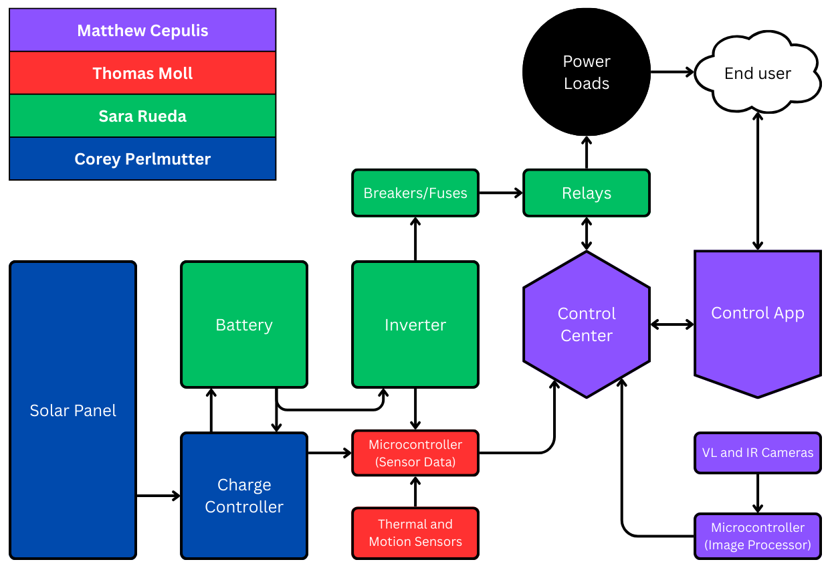
System Overview
Figure 1: System Overview diagram

Slide 4
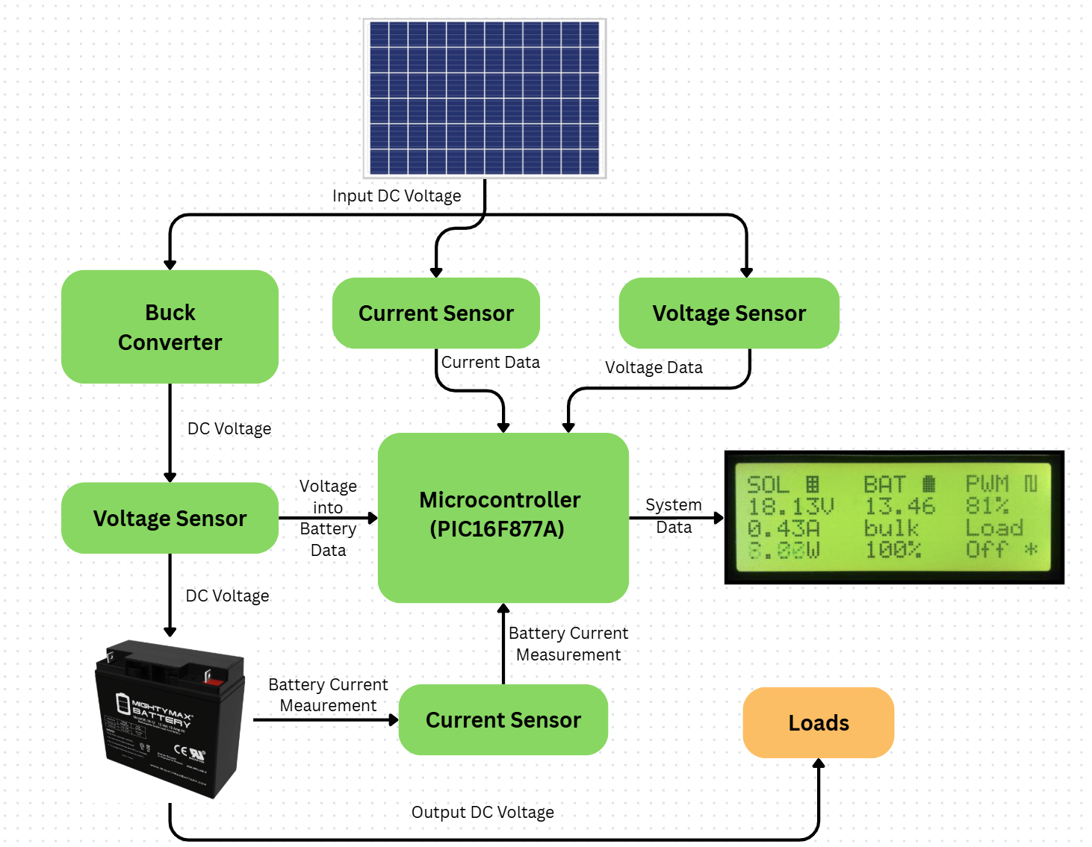
Solar Panel and Charge Controller
Subsystem - Corey Perlmutter
Figure 2: Solar Panel and Charge Controller Diagram

Slide 5
Solar Panel and Charge Controller Subsystem - Corey Perlmutter
Purpose:
Powers and charges the system’s batteries
Regulates voltage and current going into a batteries and other system
Key Functions:
Microcontroller receive vital information and controls battery charging
Switches between batteries for charging and discharging
Display to communicate important information
Connect with batteries, wiring and inverters to send power to loads
Notes:
Corey

Slide 6
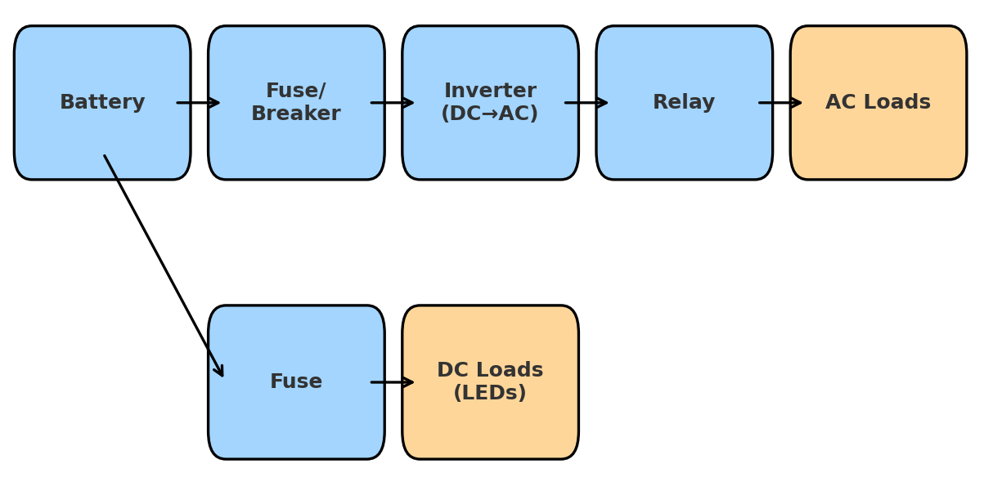
Battery and AC/DC Load Subsystem -
Sara Rueda
Figure 3: Battery and AC/DC diagram
Notes:
Blue→ represent the components that belong to subsystem (Battery, Fuse/Breaker, Inverter, Relay, DC fuse). These are the parts I’m designing and researching.
Orange → represent the loads (AC Loads, DC Loads). These are not part of your subsystem design, but they show where the power goes once it leaves your system. “We used two colors to separate what belongs to my subsystem (blue) from the actual loads we are powering (orange)”

Slide 7
Battery and AC/DC Load Subsystem -
Sara Rueda
Purpose:
Deliver safe DC and AC power.
Key Functions:
Support safe battery discharge.
Convert DC → 120 VAC, 60Hz.
Protect system with breakers/fuses.
Switch loads on/off using relays.
Subsystem Role:
Links stored solar energy to usable home power.
Ensures reliable and safe system operation.
Notes:
Sara
what, how and why

Slide 8
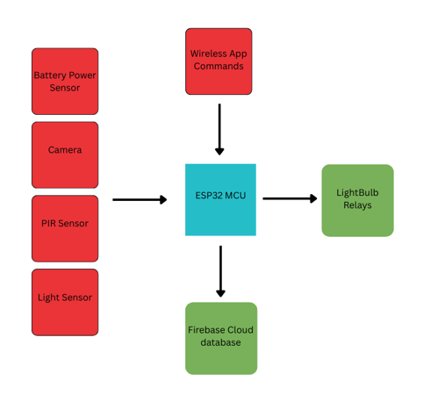
Microcontroller and Sensor Data Subsystem
Thomas Moll
Figure 4: Microcontroller and sensor data diagram

Slide 9
Microcontroller and Sensor Data Subsystem - Thomas Moll
Purpose:
To take in sensor data, trigger lightbulb relays, communicate with the cloud database, and receive commands from the app.
Key Functions:
Take in sensor data from GPIOs and upload data to firebase database.
Microcontroller will receive commands from app to trigger light bulb relays.
Sensors: PIR Sensor(Motion), light sensor, camera(IR/night vision), camera(normal), and battery sensor.
Subsystem Role:
Control lights based on commands received from app.
Take in sensor data and send to database for app to process.
Notes:
Thomas

Slide 10
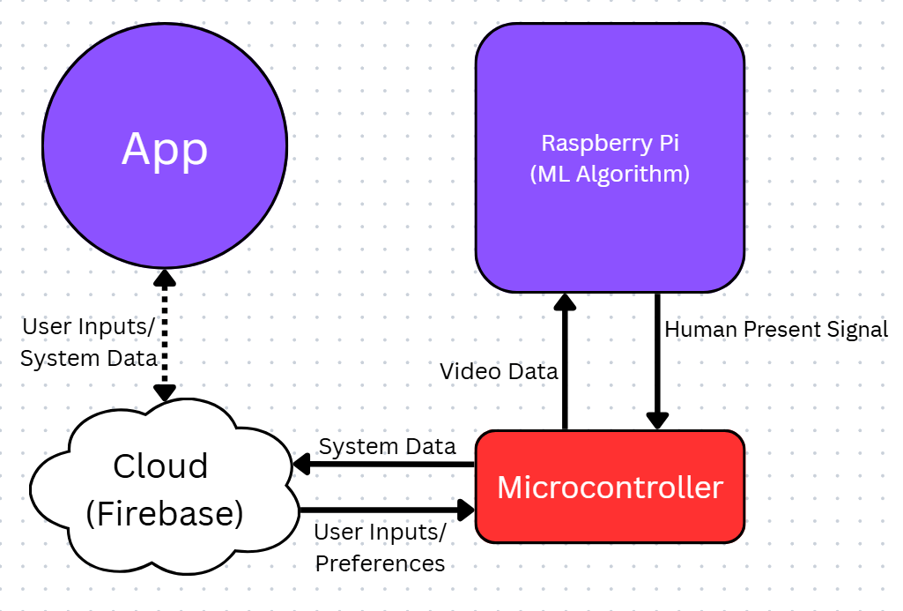
Mobile Application and Image Processing Subsystem - Matthew Cepulis
Figure 5: Mobile app and Machine Learning Subsystem Block diagram.
Notes:
Matthew

Slide 11
Mobile Application and Image Processing Subsystem - Matthew Cepulis
App:
Purpose: Provide an interface for users to interact with the solar home system.
Key functions:
Get system information (Battery Capacity, Temperature, Load & Generation info, etc.) from cloud and display to user.
Allow users to control system remotely (turn on/off lights, devices).
Supports user-set schedules and timers.
Machine Learning Algorithms:
Purpose: Process image data from Visible light and Infrared video cameras to identify humans in frame.
Key function:
Take video data (VL and IR) and determine whether a human being is in frame.
Send signal to microcontroller.
Notes:
Matthew

Slide 12
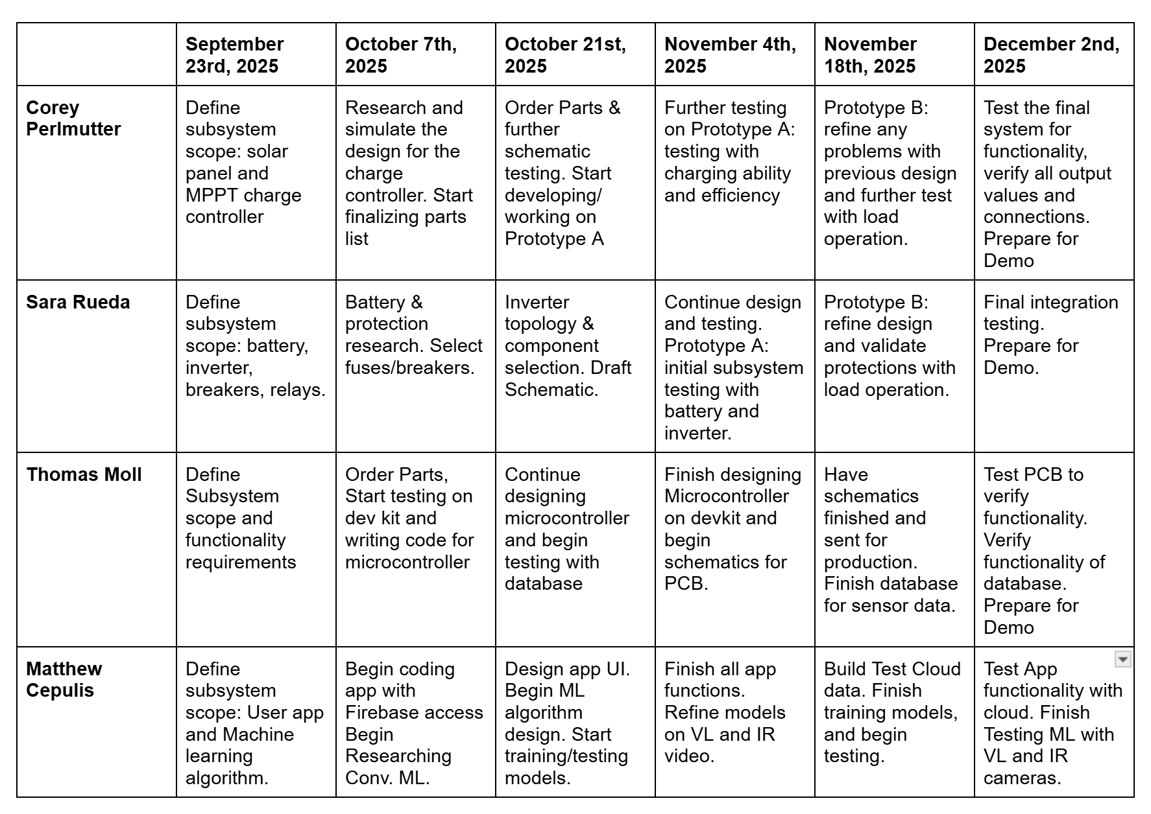
Execution and Validation
Figure 6: Tentative execution timeline for each subsystem

